Slide 1

Z80 Assembly language on the ZX Spectrum
(for C++ coders)
Notes:
Z80 assembly language on the ZX Spectrum. This is a fast paced introduction specifically aimed at C++ coders, so I won’t be explaining what a memory address or a byte is.

Slide 2
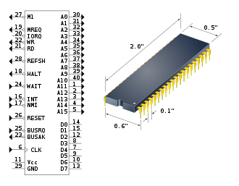
What’s a Z80
8 Bit CPU Launched in 1976 Based on the Intel 8080 158 instruction “types” Still in use today
Notes:
The Z80 is an 8 bit CPU with a 16 bit address bus. Simply put this means it can only read and write memory a byte at a time and it can only address 64k of memory.
The Z80 launched in 1976 and is based on the Intel 8080 and shares a very similar architecture but it is more advanced. The designers of the Z80 didn’t have the rights to the 8080 when they based their designs on it, so to get around the copyright they had to change the names of the instructions as the instruction names were copyrighted but the execution of those instructions weren’t.
The chip comes in different speeds, the base ones running at 2mhz, that Megahertz, not Gigahertz, with the top of the range running at 10 mhz, although it was most common to find them running between 2 and 4 mhz in most hardware. The average instruction takes 6 “clock cycles” to execute meaning even a 6mhz Z80 could only execute about 1 million instructions per second on average.
The code it runs is, unsurprisingly, called Z80 Machine code. These instruction are all very low level and simple with a lot of them only taking up 1 byte of memory, with the most complex instruction only using 4 bytes.

Slide 3
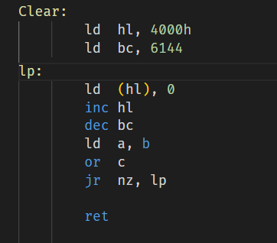
What is Assembly language?
Human readable
1-2-1 mapping
Labels instead of memory addresses
Macros and directives
Notes:
Assembly language is a human readable form of Machine code, the instruction code that a CPU executes. It differs from high level languages such as C++ in that each instruction in Assembly is directly mapped to a single operation that the CPU can execute. An assembler (the software that converts Assembly language into Machine code) usually has additional commands that assist in writing code, such as macros, labels and other commands to direct the assembler on how to build the machine code. However, these don’t add functionality, they just help you layout the code.
Assembly language is relatively easy to learn, as long as you understand how the CPU works at a hardware level. But before we get on to that there’s one last question to answer…

Slide 4
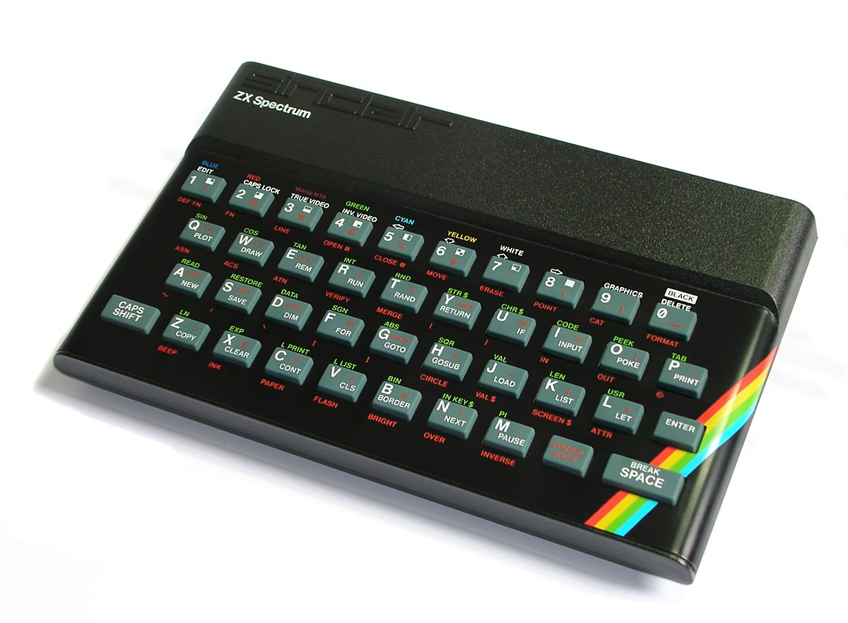
What was the ZX Spectrum?
Launchers in 1982 Sold 5 million units More than 1700 games Simple design
Notes:
The ZX Spectrum was a home computer launched in 1982. Over its 8 year popularity it sold more than 5 million units in various incarnations, not including the 5 official and over 80 unofficial hardware clones. It was the brainchild of Clive Sinclair, an inventor with a knack for making cheap electronics, and it was his 3rd home computer design.
The main reason we’re going to be using the ZX Spectrum is because of its very simple hardware design which will allow us to code Z80 Assembly language without needing to understand a lot about the hardware of the computer it’s in.

Slide 5
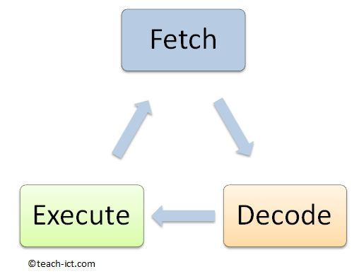
How a computer actually works
Fetch, execute, decode
PC points to address of instructions (and associated data)
Execute can trigger read/write from/to memory
Notes:
The Z80 (and most CPUs) follow a design know as von Neumann Architecture. Simply put these processors have an address bus which connects the processor to the outside world, for example memory, and a data bus that is uses to transfer data to and from the outside world, i.e. to and from memory.
The CPU has internal memory known as registers, The register memory is tiny. For example the registers in the Z80 total only 26 bytes.
Von Neumann Architecture CPUs are known as Stored Program computers because their programs are stored external to the CPU. The operate by following a sequence known as fetch, decode, execute cycle.
The fetch, decode, execute cycle is pretty self explanatory…
The CPU fetches a command from memory, it decodes this command internally to determine which part of the CPU is needed to execute the command, the command is then executed.
For the CPU to execute a command it first needs to know where that command is in memory. It uses an internal register call ‘PC’ or ‘Program Counter’ for this. This is a 16 bit register that holds the address of the next command to execute. During the fetch cycle the value of the program counter are put onto the address bus and the external hardware responds by placing the data from the corresponding memory address on the data bus. This data is then read into the CPU. At this point the Program Counter is incremented by 1 ready to read the next memory location.
Next this data is internally decoded and the relevant CPU circuitry to execute the instruction is triggered.
The execute cycle can involve more steps than this. For example, if the instruction decoded needs additional data then another fetch cycle may be initiated. This isn’t an instruction fetch but instead the execute cycle initiates a data fetch as part of the instruction execution. The external hardware doesn’t know or care what type of memory fetch the CPU is doing, it just gets a request for a byte of memory and hands it over.
Of course, the instruction executed may require a store to memory instead of a fetch from memory. This store cycle is the same as a fetch cycle but instead of the data being read into the CPU from memory, the data is put on the data bus by the CPU and written to memory.
This whole process is repeated ad infinitum.

Slide 6
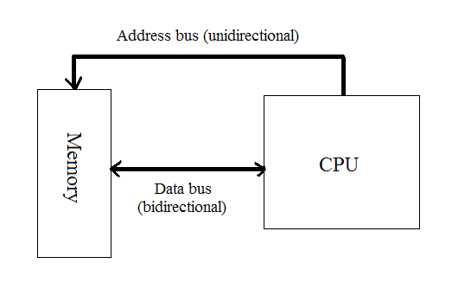
The simplest example
CPU puts PC -> Address bus
Memory puts contents of 8000h (value 00h) on data bus CPU reads 00h from data bus
CPU increments PC by 1
CPU decodes instruction 00h (NOP)
CPU executes NOP (does nothing)
REPEAT
Notes:
Lets take the simplest instruction in the Z80 language as an example. NOP or NO Operation does nothing. Literally nothing. While in Assembly language the NOP instruction is just written as NOP, in Machine Code the instruction is 1 byte in length and the value of that byte is 0.
Let’s follow the CPU reading and executing a NOP instruction
We know the CPU has an internal 16 bit register called PC or Program Counter. Let’s say the value of this register is currently 8000 in hex. You’ll almost always use hex for memory locations in Assembly language as it makes a lot more sense for many reasons that will become apparent. Anyway, at address 8000h in memory we have the Machine Code instruction NOP, i.e. the value 0.
The CPU puts the value of the PC register onto the address bus, the external electronics use this value to fetch the byte at address 8000h from the memory and place it on the data bus. The CPU then takes the data from the data bus and sends it to the decode circuitry. At this point the CPU also increments the PC ready for the next instruction fetch. This decode circuitry triggers nothing (NO Operation) and the CPU just moves on to the next cycle.
This is our full instruction cycle
PC sent to address bus PC = 8000h
Data read from data bus
PC incremented PC = 8001h
Instruction decoded and executed
Repeat

Slide 7
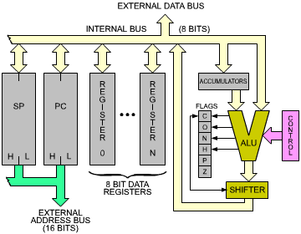
So, what else can it do?
ALU Arithmetic Logical Unit
Add, Sub, AND, OR, XOR, Compare, Bit-Shift
NO multiply, divide, Sqrt, Power etc. etc.
Contains the F register – essential for program flow
Notes:
So, a NOP is of no real use. However, you won’t be surprised to find out that a CPU has a few more instruction. Hundreds in fact, although technically only dozens of different types of instructions. This is where the ALU comes in.
The ALU or Arithmetic Logical Unit is part of the execution cycle and is responsible for all arithmetic calculations and logical operations.
The ALU inside the Z80 can do a set of simple 8 bit and 16 bit calculations. It can add and subtract, but not multiply or divide. It can do the logical bit operations AND, OR and XOR. It can shift bits and manipulate them in a few other ways but that’s about it! The ALU is also home to a special register called F which stands for Flags. This single register’s 8 bits are used to signify, i.e. flag, when some specific cases happen inside the ALU. For example, if the answer to any ALU operation results in 0 then the Z or Zero flag is set. The Zero flag is just 1 bit in the F register. Another flag is the C or Carry flag, signifying a carry has occurred in a mathematical operation. For example, adding 2 8 bit number together has resulted in an answer bigger than 8 bits. In this case the answer just loses the top most bit and the Carry flag is set.
The F register is not just used to flag the outcome of ALU operations, they are essential to program flow. Flags in the F register are used in ALL conditional program flow instruction.

Slide 8
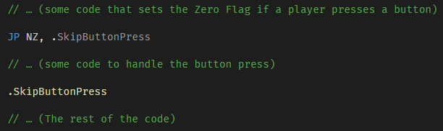
The most important bit
Notes:
This leads us neatly onto the most important bit.
The most important thing the CPU can do, is operate conditionally. For the Z80, and all CPU’s for that matter, this simply means that some instructions will execute in a different way depending on the value stored in a specific Flag.
One example of this is the JP or Jump instruction. In its vanilla form the JP instruction simply sets the value of the PC register. Since the PC register tells the CPU where the next instruction to execute is, setting this register to a different value will change where the next instruction comes from. So in Assembly language you can think of it as Jumping to a different place in the code, or to be technically correct, continuing execution from a new address in memory. The conditional form of this instruction checks if a specific flag is either set or unset and it either Jumps or does nothing. I.e. it’s an IF, but since there’s no concept of scopes or blocks in Assembly, implementing an if is a mater of skipping over code you don’t want to execute.
In this pseudo example we have some code that will set the Zero Flag if a player presses a button. We then use the JP instruction to jump if NOT ZERO (NZ) to a different memory address, skipping over the code we want to execute if the zero flag was set.
The SkipButtonPress is a label. This is an assembler helper that lets us specify locations in the code that are translated directly into the memory location of the instructions that follow the label. In the assembler I’m using local labels start with a dot. The assembler I’m using has local labels and global labels. The difference being, local labels can be reused between global labels. Since the language IS defined but the assembler directives are not, you’ll find different assemblers have a different syntax for things like labels and macros.
And that’s it! Conditional execution is as simple as that. EVERYTHING the CPU does to make decisions is based on the Flag register and the small set of instructions that can change program flow based on these flags.

Slide 9
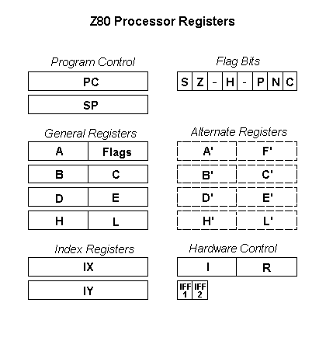
More registers
PC – Program Counter SP – Stack Pointer A – Accumulator B,C,D,E,H,L – general purpose registers HL – 16-bit accumulator AKA High/Low IX/IY Index registers, Alternate registers, I & R, ask me later…
Notes:
So, we’ve covered the Program Counter register and the Flags register. The ones we haven’t covered, the main set of registers, are the general purpose registers which are used by the ALU for its operations. These are A, B, C, D, E, H & L. There are a few more, but they are special use cases which we won’t go into at the moment.
All of these registers are 8 bit, however some instruction can use pairs of these registers for 16 bits operations. It is important to remember though that they are just being used as pairs and if, for example, you see BC used it is just using the B and C registers as a pair.
Some registers are general purpose and some have a very specific purpose, such as the F register. Another specific purpose register is the Accumulator, or A register. This register is the target result register for all 8 bit ALU mathematic operations. More on that in a moment.
The B, C, D, E, H and L registers are all general purpose, however H & L when used as the pair HL is the target result register for 16 bit ALU mathematic operations. The H and L are sometimes referred to as High and Low, signifying that the H is the High part of the HL 16 bit pair and the L is the Low part.

Slide 10
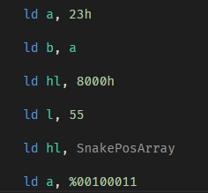
Moving numbers around
Most 8 bit registers can be loaded with values
16-bit register pairs are loaded the same way
Labels and defines can be used for ease
The assembler can handle decimal, hex, binary and even octal!
Notes:
Now we know our general purpose registers lets get to some actual code
The LD or “Load” instruction is used to “load” a value from one place to another. A more logical name for this would be “move”. Unfortunately the 8080 uses the name Move (actually mov) and as we learned back on slide 2, that instruction is copyrighted so the Z80 uses Load.
Take the following instruction.
LD A, 23h
This “Loads” the value 23h into the A register.
In machine code this instruction is 2 bytes long, the first being 3E and the second 23h. 3Eh is the instruction to load a byte value into the A register. The 23h is stored in memory directly after the instruction. As the CPU executes the 3E instruction it fetches the next byte from the PC address, in this case 23h, and put is into the A register
How about this instruction
LD B, A
This “Loads” the value that is currently stored in the A register into the B register. When we say “Load” we mean copy as nothing happens to the original value or register.
This instruction in Machine Code is 47h and is 1 byte long.
In these examples you can also see we can load a 16 bit value into a 16-bit register pair. Here we’re loading 8000h into hl. This instruction will take up 3 bytes in memory, 1 byte for the instruction and 2 bytes to hold the 16 bit value to load. We can also load values directly into the general purpose registers. Here we’re loading the decimal value 55 into l
The line ld hl, SnakePosArray is the same as loading a number into HL, but here we’ve used an assembler label instead of a number. SnakePosArray is somewhere else in our code and represents the memory address of where that label will be. Alternatively SnakePosArray could be a define. Defines are sometimes called equates, represented by EQU in some assemblers. Assemblers are the wild west of code builders!
Lastly we’re loading a with a binary value, in my assembler represented by a percent at the beginning or a B at the end.

Slide 11
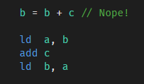
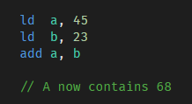
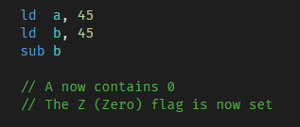
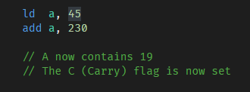
Some simple math
Notes:
So, we now know we can set a register value either from a direct number stored in memory alongside the instruction or from another register. That’s great but we need to do more than that, especially if we want to do some logic. Let’s look at some simple math
As mentioned before, the Accumulator is the default target for 8 bit mathematic operations. This means anything we want to add always ends up in A. In fact all 8 bit mathematical operations use A.
Let’s do an example. If we had a value in the register B and a value in the register C and we wanted to add them together and store the result in B we can’t simply add them together like we do in C++
B = B + C ; Nope!
In Assembly we’d need to do this
LD A, B
ADD C
LD B, A
First we load B into A – the syntax of this is LD A, B, i.e. load A from B (confusing eh!), then we add C to A (note we don’t need to specify A as the thing we’re adding C to as it’s implied), then we load A back into B i.e., load B from A
We’ve now successfully added C to B. However, you may notice we have overwritten the A register in the process. Since A is used for most things mathematical you’ll not keep values in it long. The Z80 has very few registers so it’s rare a register will hold a value for any length of time as you’ll usually store any useful data back to memory.
In the second example we’re adding 45 to 23 using the b register to hold 23. The answer, which is always in a, is now 68
The third subtracts 45 in the B register from 45 in the A register, the answer, zero, will again be in the Accumulator. Because the answer is zero, the Zero flag is set to signify the result from an ALU operation is zero. Notice here that we’ve used SUB B instead of SUB A, B. For reasons unbeknown to be, the syntax for sub omits the A part, although it always operates on A. There are a few other instructions that are written like this. Luckily most assemblers will allow you to add it to sub and omit it from add for example.
In the last example we’re adding 45 and 230. Because the answer to this, 275, is too big to fit in a byte, the additional bit is lost and the answer is 19, but the Carry flag is set to show that there was a ‘carry’ to this addition.

Slide 12
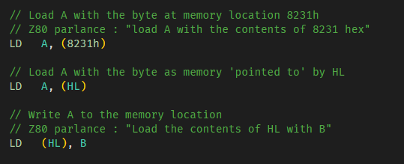
Using memory
Memory addresses can
Notes:
We’ve touched upon loading registers with immediate values, i.e. values that immediately follow the instruction itself in memory. However, we probably want to access any memory anywhere to move data around. This is covered by direct addressing and indirect addressing. Direct addressing is where you specify the address of the memory to read or write by putting the address alongside the instruction in a similar way that we specified an immediate value. Indirect addressing is where you use a 16 bit register pair to specify where in memory you want to read or write.
Direct addressing looks like this
LD A, (8231h)
Reads as load A from the contents of 8231h
This loads the byte from memory address 8231h into the A register. Note the use of brackets to specify “contents of” address 8231h. If the byte at memory address 8231h contains the number 7, the A register would now equal 7.
In reality you’ll unlikely be using numbers for memory locations unless you want to keep track of the position in memory of all of your data by hand. Usually you’d let the assembler help you and you’d have LD A, (someLabel or define).
Indirect addressing looks similar but we use a register pair instead of the direct address to specify where to read or write from. For example
LD A, (HL)
Reads as load A from the contents of HL, meaning the contents of memory that is pointed to by the register pair HL. If HL contained the number 9231h then A would now contain whatever value was stored at memory location 9231h.
Z80 programmers use the phrase “contents of” a lot, which can get a little confusing, especially when using indirect addressing. The last line, LD (HL), B is putting the contents of the B register into the memory location pointed to by HL. However, people will say “Load the contents of HL with B”, which suggests you’re loading the HL registers with the value in B, which you are not. “The contents of” makes send when using memory addresses, i.e. “the contents of 8000h”, but not with indirect addressing, but yet it’s still used.

Slide 13
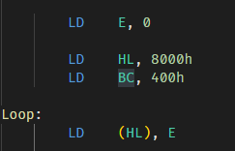
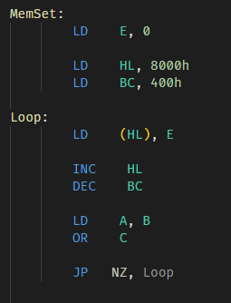

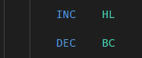
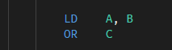

Making something useful
Notes:
Let’s try and put some of the things we’ve covered into an actual useful snippet of code and see if we can introduce some more instructions at the same time along with finding out about the frustrating limitations of the Z80’s Machine Code, and actually most CPU’s Machine code.
We’ll make something similar to the C library function memset.
Memset takes an address, a length and a value so let’s say we want to set 400h bytes at address 8000h to zero. This will obviously require some kind of loop and a way to address the 400h consecutive bytes starting at 8000h.
We know we can indirectly address memory using the HL register as a pointer, so let’s start by setting the HL register to 8000h. This will point to our first byte and can be done quite simply by doing
LD HL, 8000h
Easy! Next we want a way to store a zero to the memory pointer to by HL.
LD (HL), 0
Well that will work, but maybe we want is a little less hard coded. Let’s use a register to specify the value we want to write to memory. Let’s chose the E register for this. I’m not going to choose A as we know that’s used a lot for all maths operations so probably not a good idea to rely on it to remain zero during our loop.
LD E, 0
And we can write it to memory using
LD (HL), E
So we have our register containing the value to write and a register that points to the first byte of the memory we want to write to. We also need a loop counter. Let’s use BC 16 bit register pair because the number 400h if too big to fit into an 8 bit register.
LD BC, 400h
Now we know how to set up our address, our loop counter and our value to write and we know how to use indirect addressing to write it to memory we can move on to our loop
LD E, 0
LD HL, 8000h
LD BC, 400h
Loop:
LD (HL), E
This is what we have so far. Notice the Loop: before the last line. This isn’t an instruction, remember, it is a label. When the assembler finds a word followed by a colon it notes down the memory address where the next instruction will be in memory.
The next thing we need to do is increment our memory pointer to the next address in memory. This is how we do it.
INC HL
The INC instruction increments a register or register pair by 1. There are a few other things that INC can do that we can cover later.
So far so good. Next we want to decrement our loop counter. I think you can see what’s coming…
DEC BC
This decrements the register pair BC by 1
Excellent, so next we need to check if our loop counter has reached zero yet, and if not we want to loop back to where we write zero to memory.
Remember back when we talked about the Zero flag that gets set when the result of an arithmetic operation is zero? Well, DEC is an arithmetic operation! Unfortunately you’re out of luck because DEC only modifies the zero flag when you decrement an 8 bit register not a 16 bit register! Why? Cause reasons!
So we’re going to have to find another way to test if the register pair BC is zero.
It may sound obvious, but being zero means all 16 bits are zero. There is no easy way to check for zero bits on the BC register pair. However there’s plenty we can do with the 8 bit registers B & C. Let’s write a couple of lines of code that test the bits in both registers and sets the zero flag if the result is zero.
LD A, B
OR C
We load the value from B into the accumulator then we do the bitwise OR operation between A and C which stores the answer in A. If any bits in either the B or C register was a 1 then there will be a 1 in the corresponding bit in the answer. The only way the accumulator can be zero after the OR is if both B & C were both zero, i.e. BC is zero and the zero flag is set. Note here that if the answer was not zero the zero flag is reset, so either way it’s always written to.
So now we are ready to loop and we know if the loop ended if the zero flag is set, so let’s do it.
JP NZ, Loop
Remember the conditional Jump instruction? This instruction will only jump if the zero flag is reset, i.e. Not Zero, NZ
You may remember that a JP instruction just sets the PC (Program Counter) register to the value supplied, in this case the value supplied is the label Loop which will be set by the assembler to the address of the LD (HL), E instruction.
So now we have out complete loop. We set up the address to write to, a loop count and a value to write. We write the value, increment the pointer to memory, decrement the loop count, test if it’s zero and loop if it wasn’t! And that’s it! We’ve zero’d the memory!

Slide 14
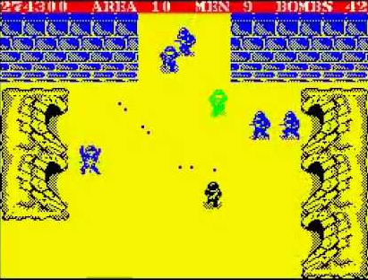
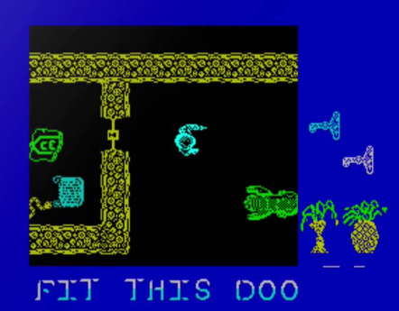
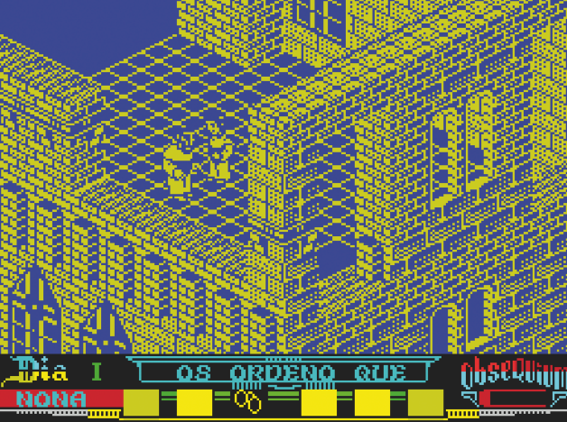



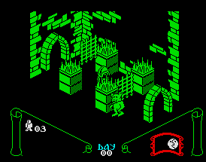

So it that it?
Notes:
There’s a lot more to Z80 that what we’ve covered so far, but not actually that much more. We can set both 8 and 16 bit registers, we can use direct and indirect addressing to access memory and we can conditionally jump based on the state of a flag. We’ve touched on the ALU that can do math functions.
Now we’ve got the basics covered I think we should jump into a larger example with a lot more instructions that will hopefully not seem too different from what you’d learned so far.
In this example we’ll cover subroutines and the stack, reading and writing to other things than memory and displaying things on the screen of the ZX Spectrum. We’re going to make a snake game!

